Slide 1
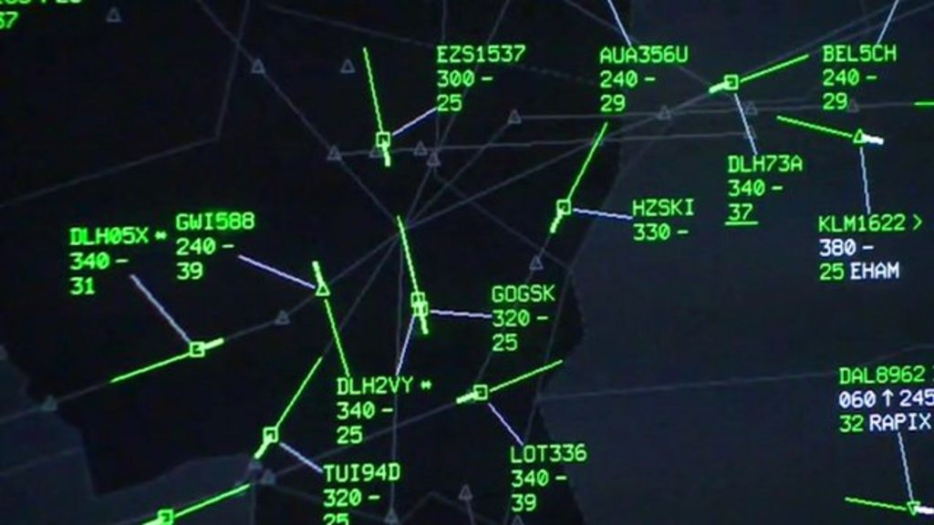

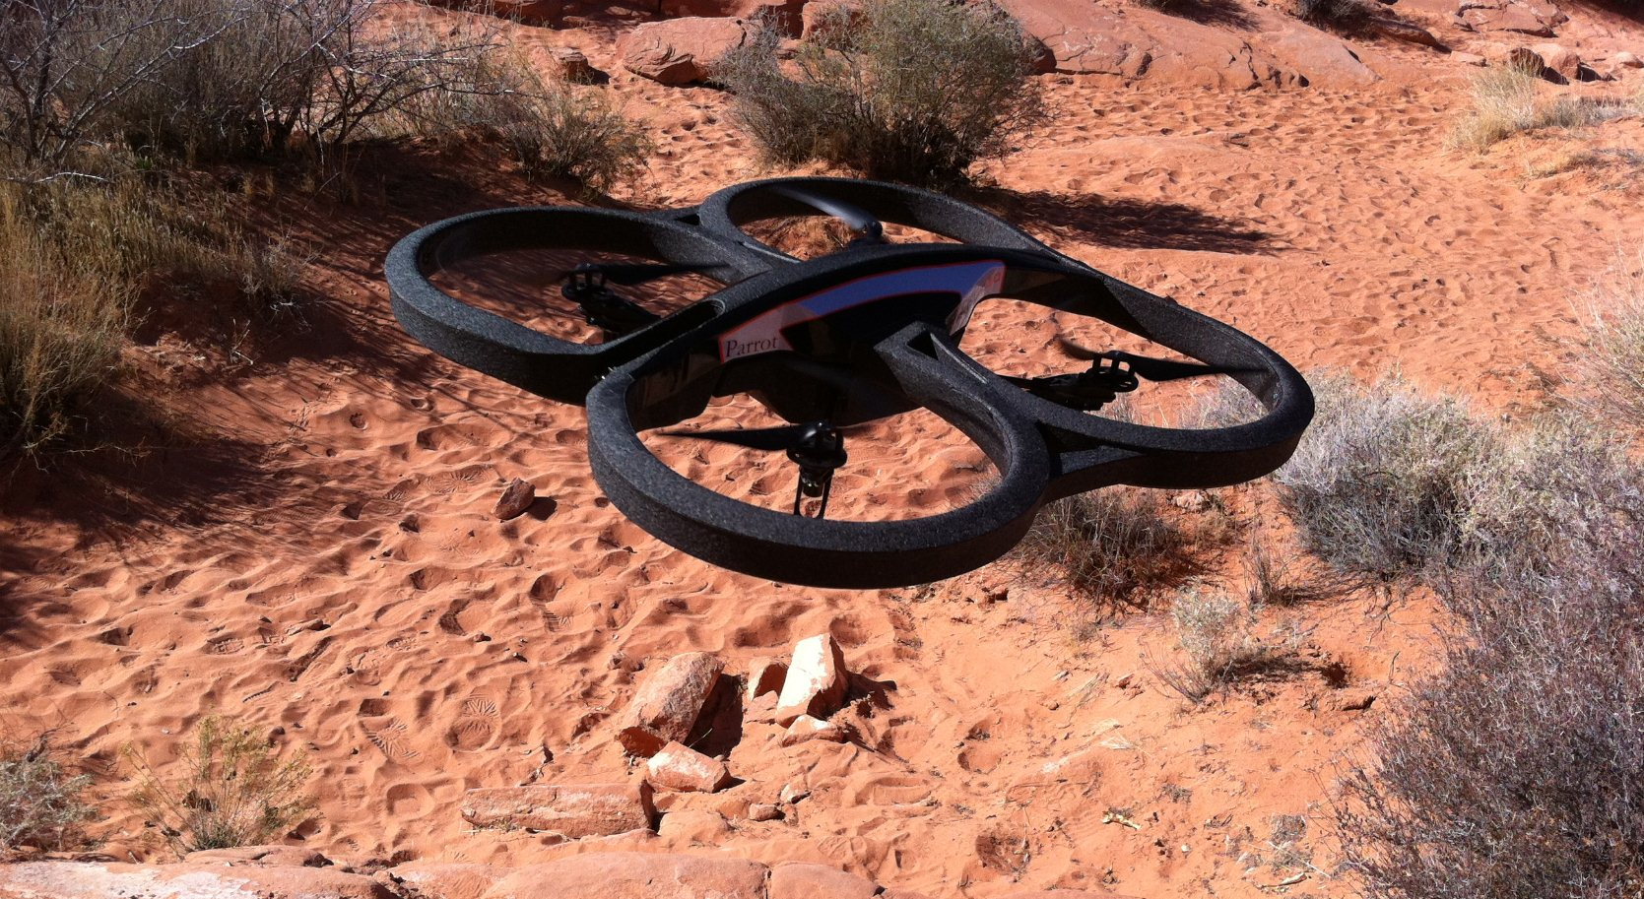
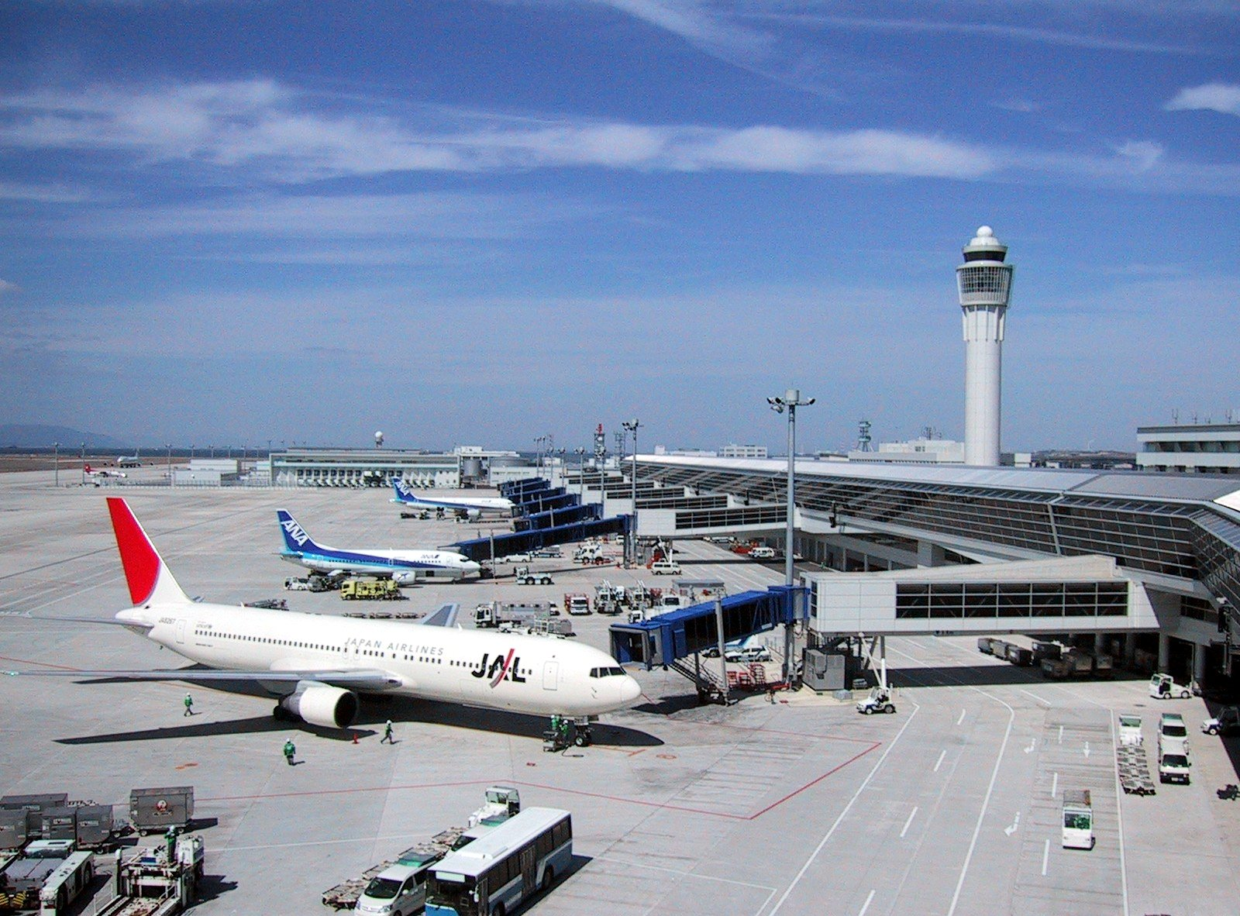
Air Traffic Control
Quick Introduction and Autonomous Drone Project Motivation
Max Z. Li
Department of Electrical & Systems Engineering
University of Pennsylvania
Megan S. Ryerson, Ph.D.
Department of City & Regional Planning
Department of Electrical & Systems Engineering
University of Pennsylvania
1
Notes:
http://ichef-1.bbci.co.uk/news/1024/media/images/63563000/jpg/_63563649_atc.jpg
http://weknowyourdreams.com/images/airport/airport-05.jpg
https://upload.wikimedia.org/wikipedia/commons/c/c0/Parrot_AR.Drone_2.0_take-off,_Nevada.jpg

Slide 2
Air Traffic Control
Governance in the sky for civilian and military operations
Airspace efficiency (civilian)
Defense capabilities (military)
Visual and instrument navigation (both)
Completion of flight objective (both)
SAFETY (both)
Present: Highly structured civilian airspace for commercial aviation
Example: Chicago O’Hare International Airport (ORD)
Future: Segregated airspace for commercial aviation and high-density autonomous traffic
Amazon UAV delivery
Google and Chipotle’s drone delivery
Challenges to ATC?
2
Notes:
http://www.bloomberg.com/news/articles/2016-09-08/burrito-by-drone-coming-to-campus-in-test-of-alphabet-s-delivery
https://www.amazon.com/b?node=8037720011

Slide 3

Terminal Radar Approach Control (TRACON) Airspace
An example of a highly structured airspace
$→$ Chicago TRACON
3

Slide 4


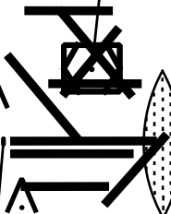

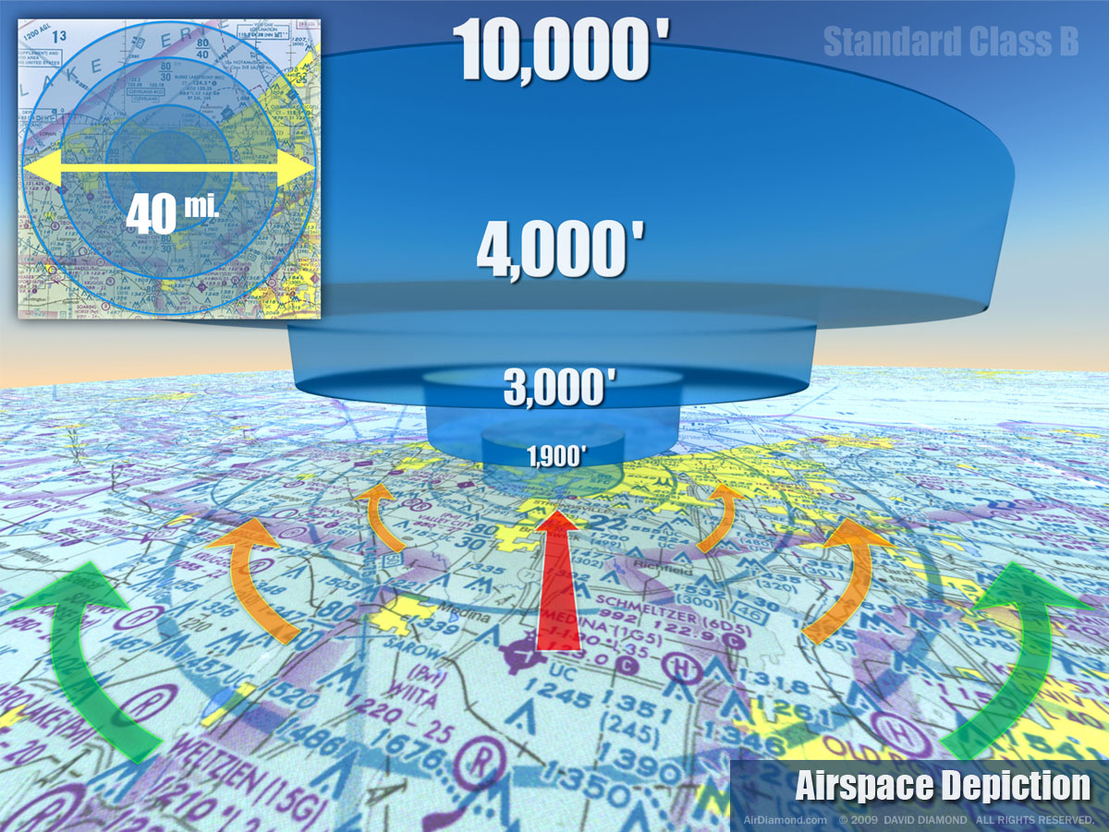




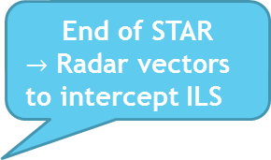




$$A_{1}^{ORD}$$
$$A_{5}^{ORD}$$
Arrival fix
Enters TRACON
STAR begins
End of STAR
$→$ Radar vectors to intercept ILS
MKE
FL100
FL090
FL070
ORD East Flow
$$A_{1}^{MKE}$$
Hit assigned turn
ORD
IAF
ILS captured
IAP begins
FAF
$$A_{4}^{ORD}$$
ORD West Flow
MDW
$$A_{2}^{ORD}$$
Hit assigned altitude
Departure fix
$$A_{2}^{MDW}$$
$$A_{3}^{ORD}$$
$$A_{1}^{MDW}$$
4
Notes:
http://2.bp.blogspot.com/_9JlIA13FIzw/SxL8hKhlUUI/AAAAAAAAAJg/q8wR5xZJHgQ/s1600/Blog-Scene-AirspaceDepiction.jpg

Slide 5
ORD Arrival
Airspace
$$A_{1}^{ORD}$$
$$A_{5}^{ORD}$$
MKE
FL100
FL090
FL070
ORD
ILS
$$A_{1}^{MKE}$$
ILS
ILS
$$A_{4}^{ORD}$$
MDW
$$A_{2}^{ORD}$$
ORD Departure
Airspace
$$A_{2}^{MDW}$$
$$A_{3}^{ORD}$$
$$A_{1}^{MDW}$$
4

Slide 6
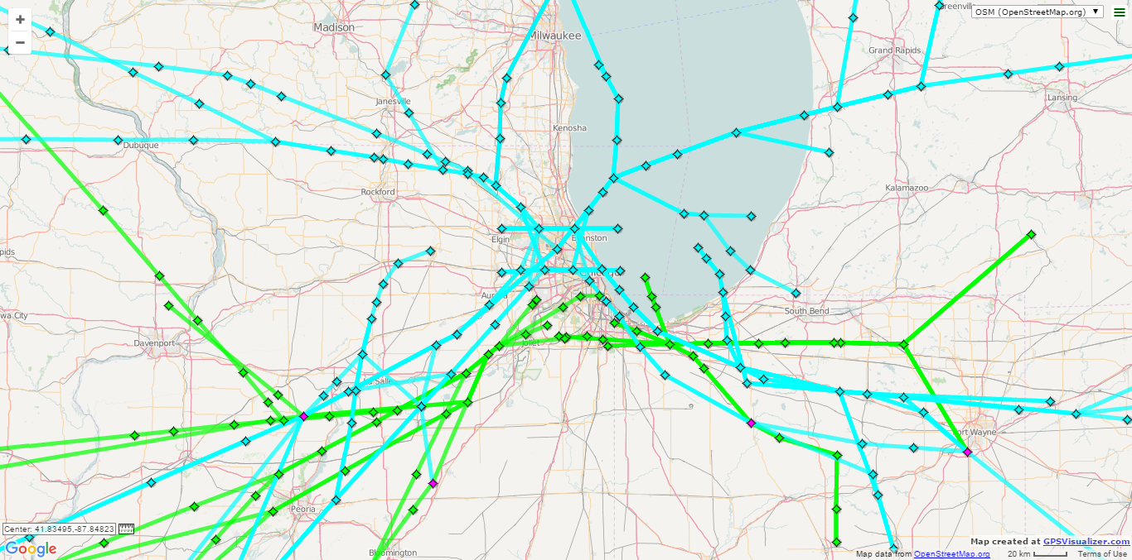
ORD and MDW STARs
5

Slide 7
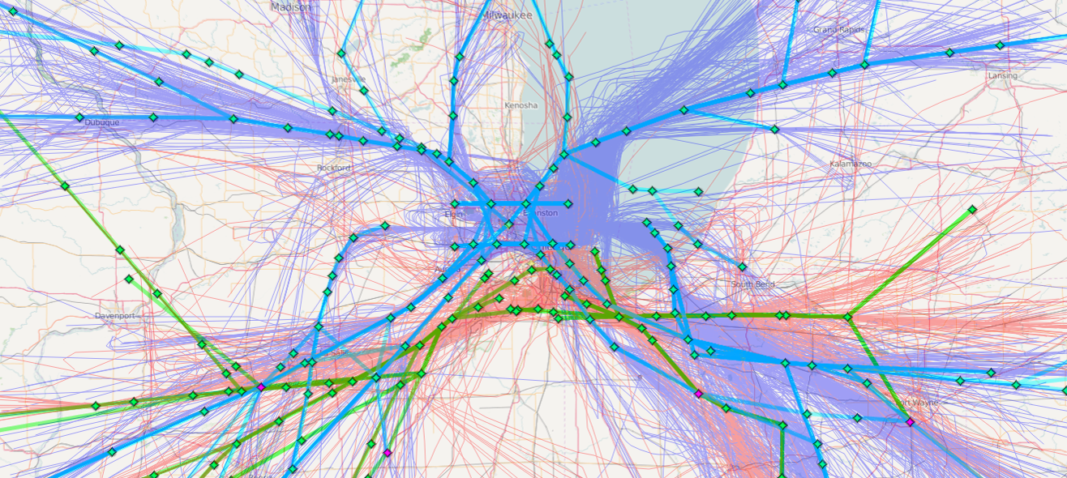
ORD and MDW STARs (with flights overlaid)
6

Slide 8
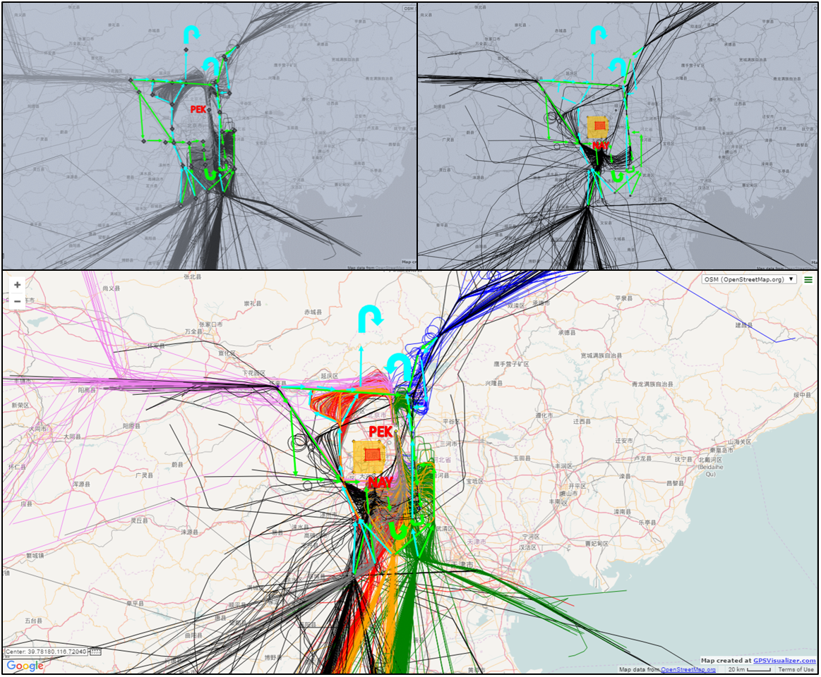
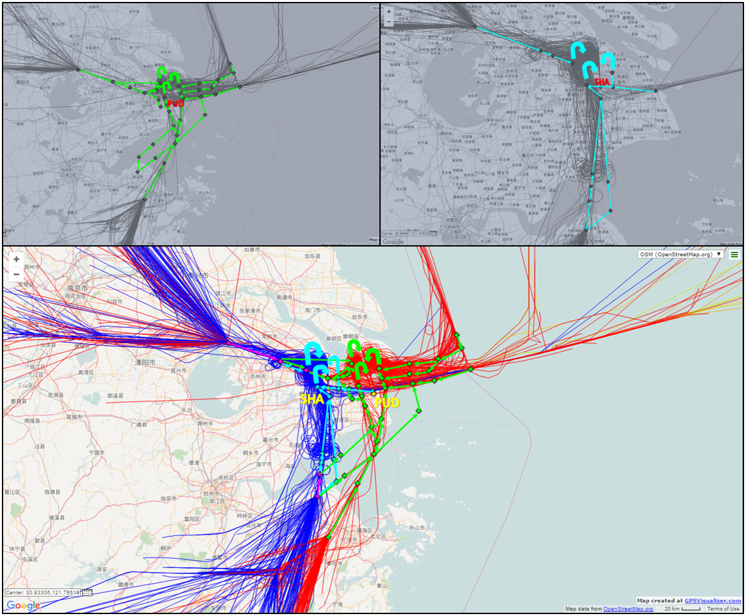
7

Slide 9
Drone ATC vs. Commercial ATC
Highly structured airspace
Static and hierarchical points-of-reference
En-route centers
TRACONs
Airport tower
Ramp tower
Set schedule of landings
Landing sequence mostly reflects scheduling, subject to external factors
Decentralized airspace
Portable, singular point-of-reference
Could be arranged together
Vision is portable ATC setups
ATC must coordinate on a semi-ad-hoc basis between drones waiting to land
Lost-link situations
Others?
12

Slide 10
Outline of Possible Developmental Steps
Towards a Pop-Up Autonomous ATC Setup for Drones
13

Slide 11
Milestone 1-1: Fly-in-sequence (preprogrammed)
D1
D3
D2
D4
D1
D1
D1
1
2
3
4
D1
14

Slide 12
Milestone 1-2: Land-in-sequence (preprogrammed)
D2
D4
D1
D1
1
2
3
4
D3
15

Slide 13
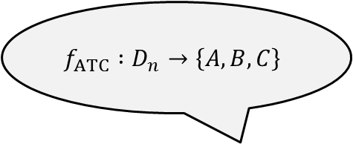
Milestone 2: Land-in-sequence (ATC-directed)
D2
D4
D1
D1
A
B
C
D3
$$f_{ATC} :D_{n}→\left\{A, B, C\right\}$$
ATC
16

Slide 14
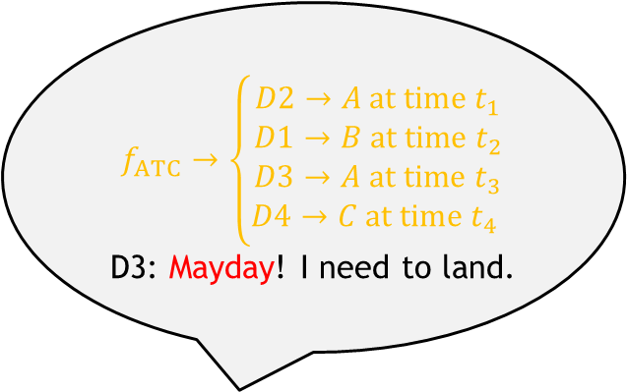
Milestone 3-1: Simulation of mayday event
D2
D4
D1
D1
A
B
$$f_{ATC}→\left\{\begin{aligned}D2→A at time t_{1} \\ D1→B at time t_{2} \\ D3→A at time t_{3} \\ D4→C at time t_{4} \end{aligned}\right.$$
D3: Mayday! I need to land.
C
D3
ATC
17

Slide 15
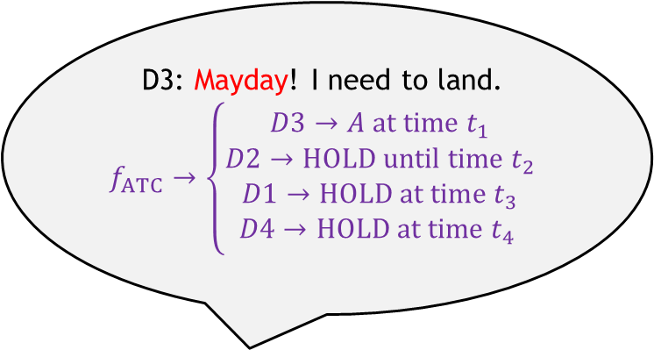
Milestone 3-1: Simulation of mayday event
D2
D4
D1
D1
A
B
D3: Mayday! I need to land.
$$f_{ATC}→\left\{\begin{aligned}D3→A at time t_{1} \\ D2→HOLD until time t_{2} \\ D1→HOLD at time t_{3} \\ D4→HOLD at time t_{4} \end{aligned}\right.$$
C
D3
ATC
18

Slide 16
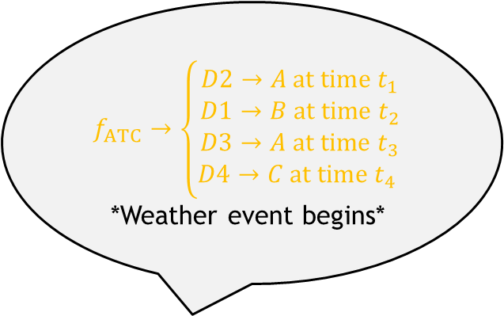
Milestone 3-2: Simulation of airfield event
D2
D4
D1
D1
A
B
$$f_{ATC}→\left\{\begin{aligned}D2→A at time t_{1} \\ D1→B at time t_{2} \\ D3→A at time t_{3} \\ D4→C at time t_{4} \end{aligned}\right.$$
*Weather event begins*
C
D3
ATC
19

Slide 17
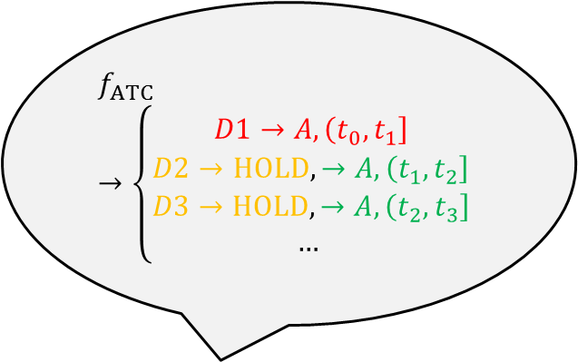
Milestone 3-2: Simulation of airfield event
D2
D4
D1
D1
A
B
$$f_{ATC}→\left\{\begin{aligned}D1→A, \left(t_{0}, t_{1}\right] \\ D2→HOLD, →A, \left(t_{1}, t_{2}\right] \\ D3→HOLD,→A, \left(t_{2}, t_{3}\right] \\ … \end{aligned}\right.$$
C
D3
ATC
20

Slide 18
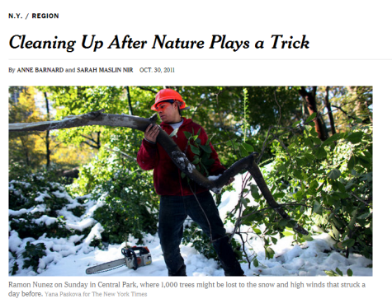
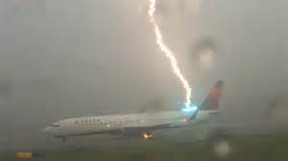
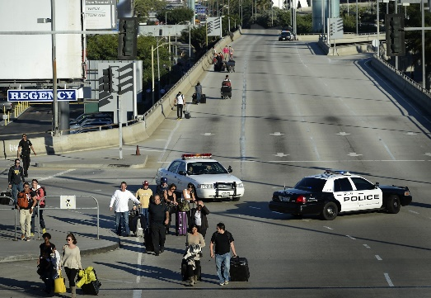
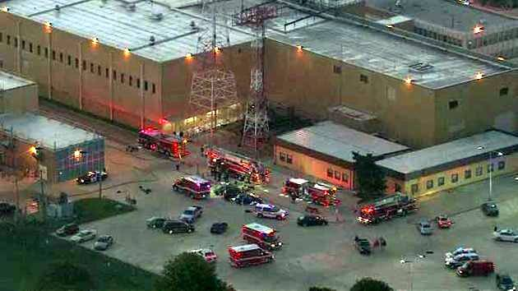
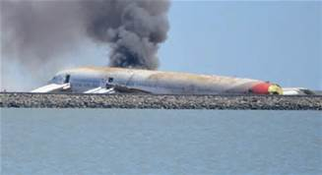
Few critical hubs mean airlines are highly vulnerable to outages at those hubs
Weather-based Outages
The “Halloween Nor’easter”
Thunderstorms over Atlanta Airport
The Great Tōhoku Earthquake
Accident/Terror-based Outages
Shooting at Los Angeles International Airport in 2013
Arson at the Chicago Air Route Traffic Control Center
Asiana Airlines crash at San Francisco International Airport in 2013
8
Notes:
Arson at the Chicago Air Route Traffic Control Center caused 2,000 flights to be diverted

Slide 19
Diversions ahead
9

Slide 20
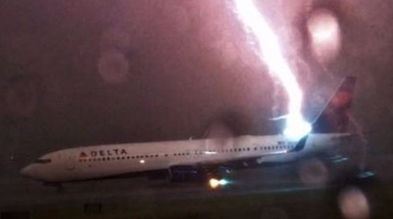
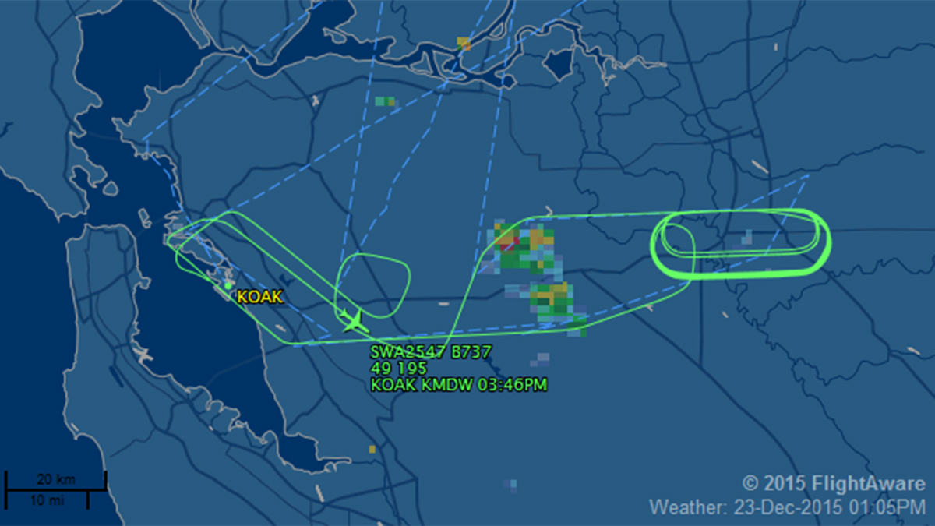
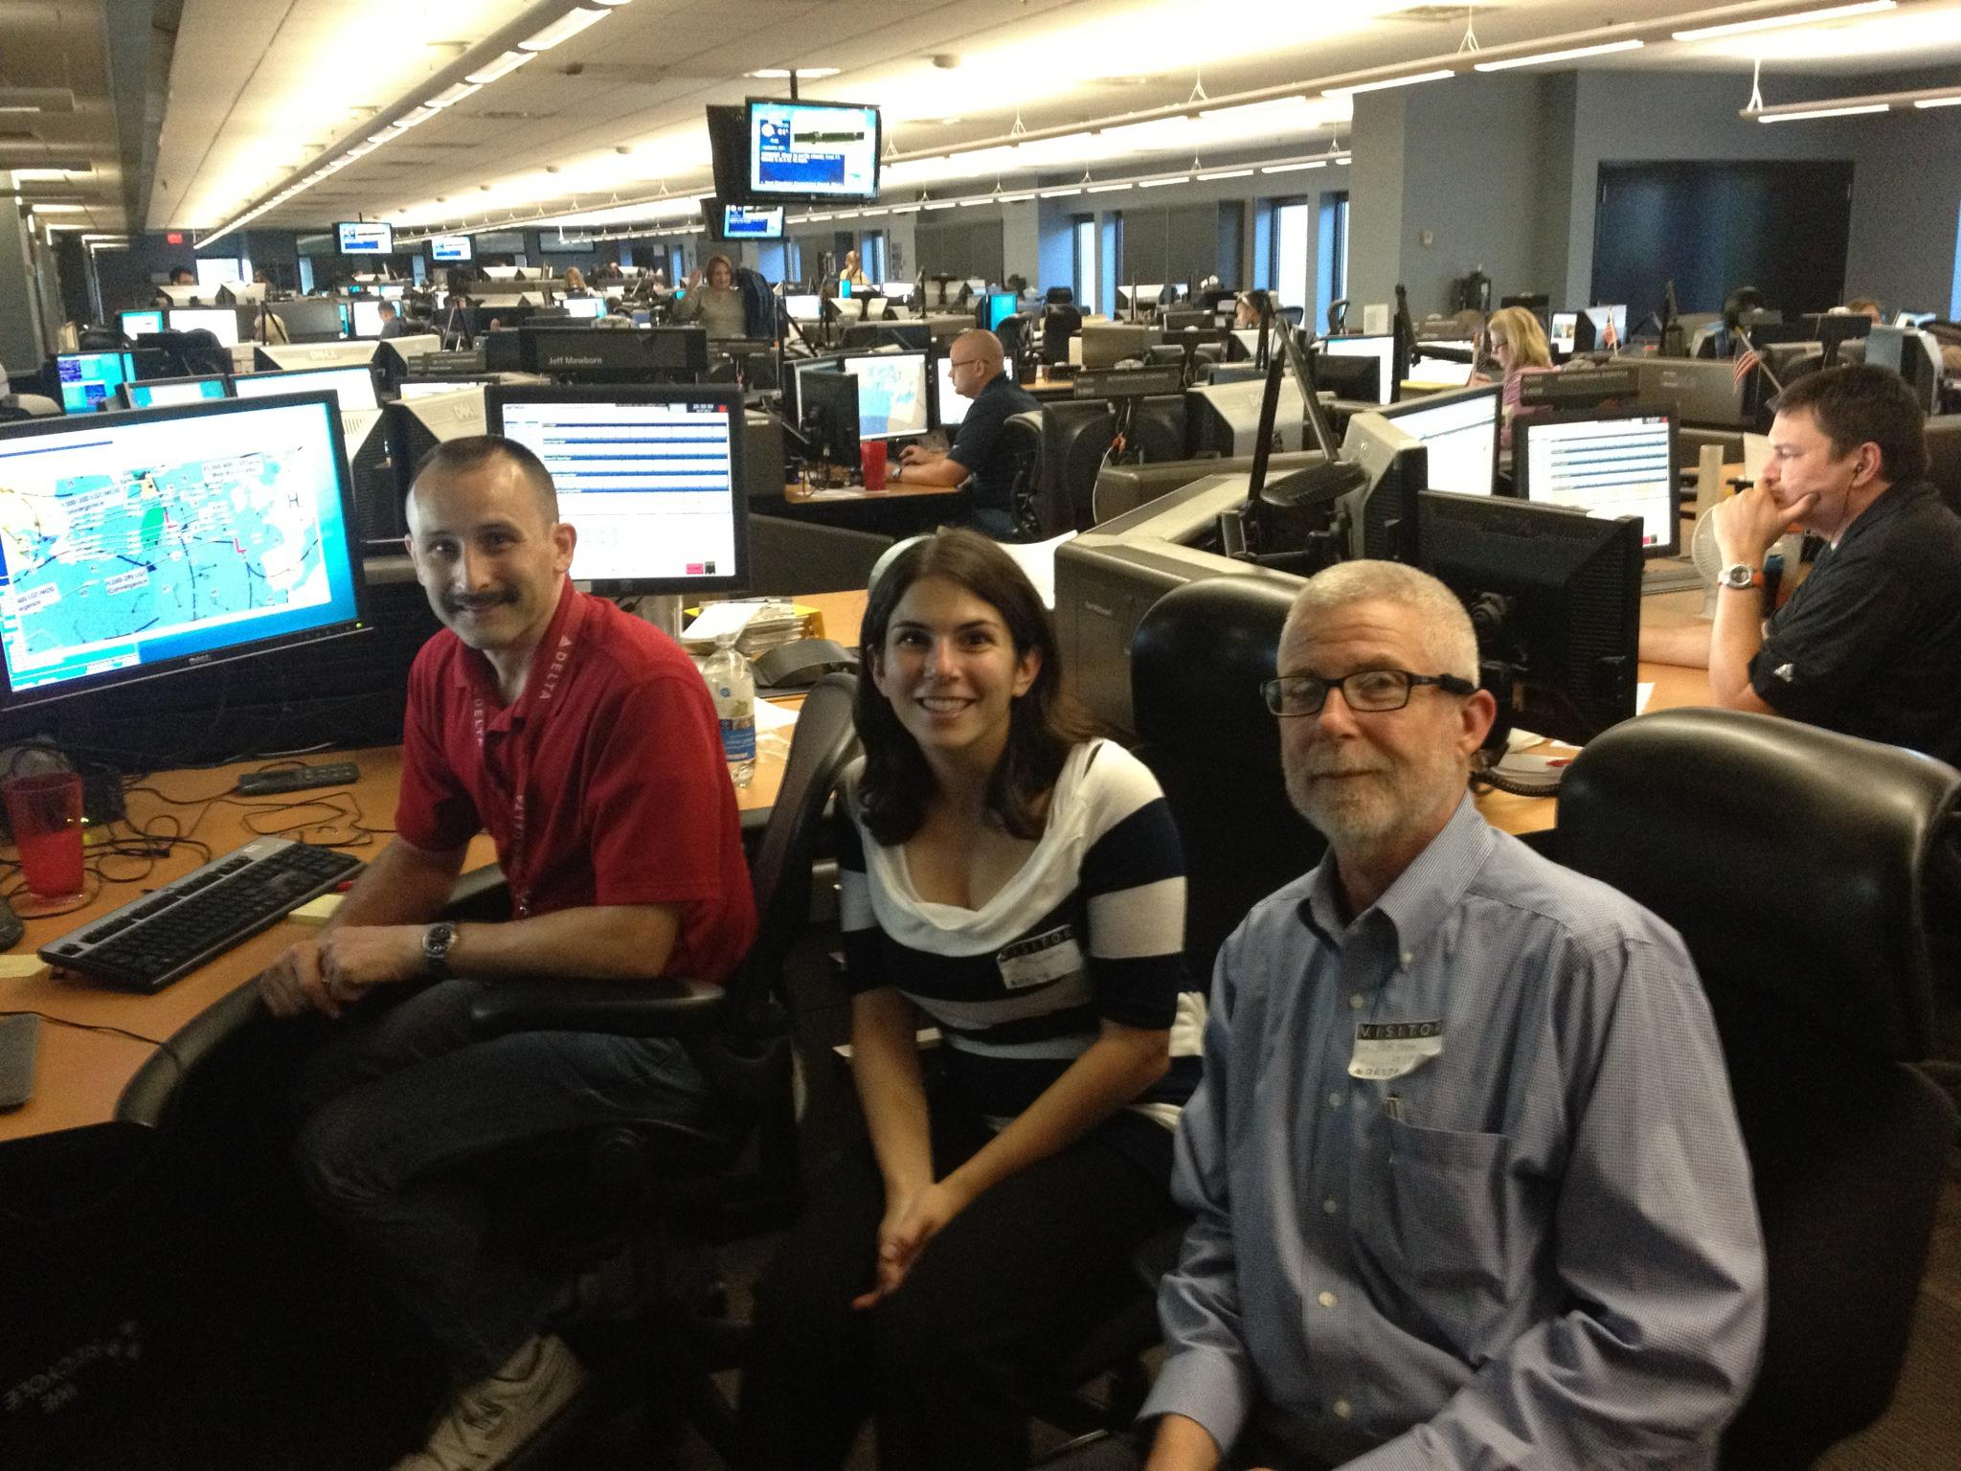
 | 1st Qu. | Median | Mean | 3rd Qu.
Cost to Carry Contingency Fuel
Cost to Carry (lbs) | 58.48 | 131.50 | 225.20 | 316.00
Percent of total per-flight fuel consumed | 0.57% | 1.04% | 1.74% | 2.54%
10

Slide 21
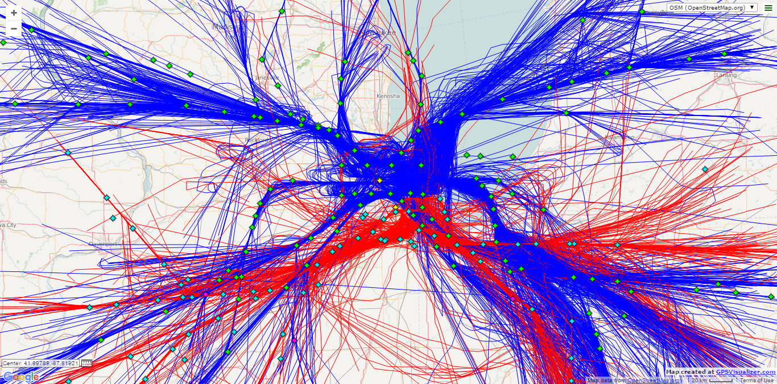
Project Motivation
Autonomous ATC for drones
Coordination between several quadrotors in simulated TRACON environment
Can you have 3 or 4 quadrotors follow a preset series of waypoints and land in a specific sequence?
Can you establish communication protocols to give real-time ATC directives (holding, new routing, etc.)
Can you simulate real TRACON contingencies (medical priority, mayday calls, closure of a certain sector of the TRACON airspace, etc.)?
11

Slide 22
Thank you!
Questions? Comments?
21

Slide 23
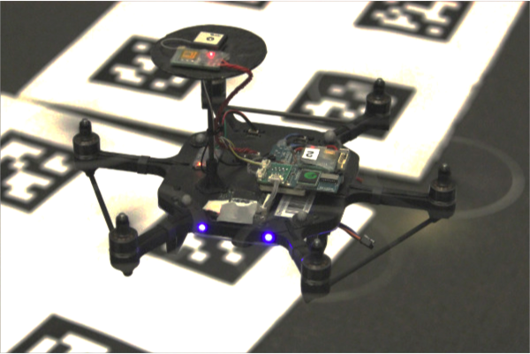
ArduCopter: DIY Quadcopter
http://ardupilot.org/copter/
Notes:
e.g. huge battery packs in EVs

Slide 24
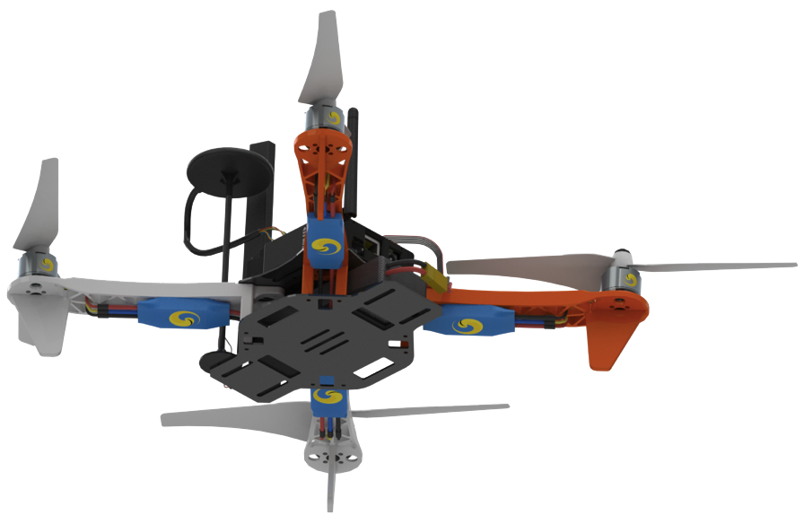
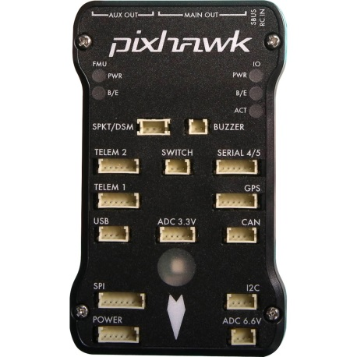
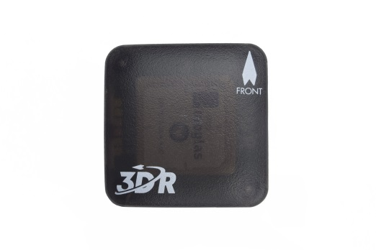
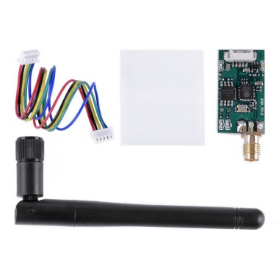
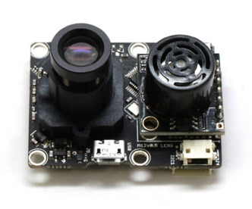

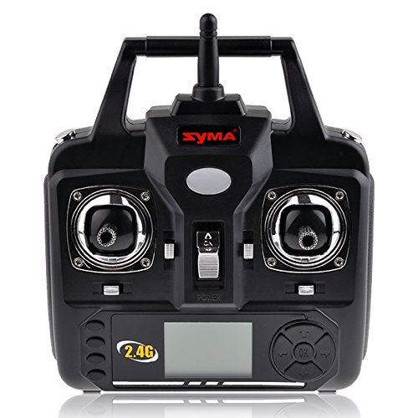
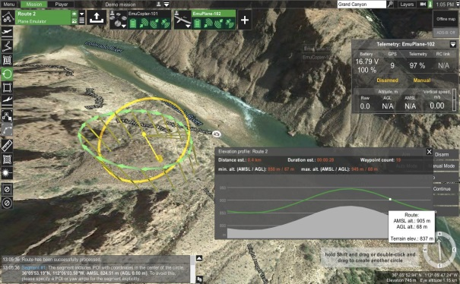
Key components
Quadcopter platform
Flight Computer + Sensors + Communication
Ground Station (full/semi autonomous)
Controller (manual)

Slide 25
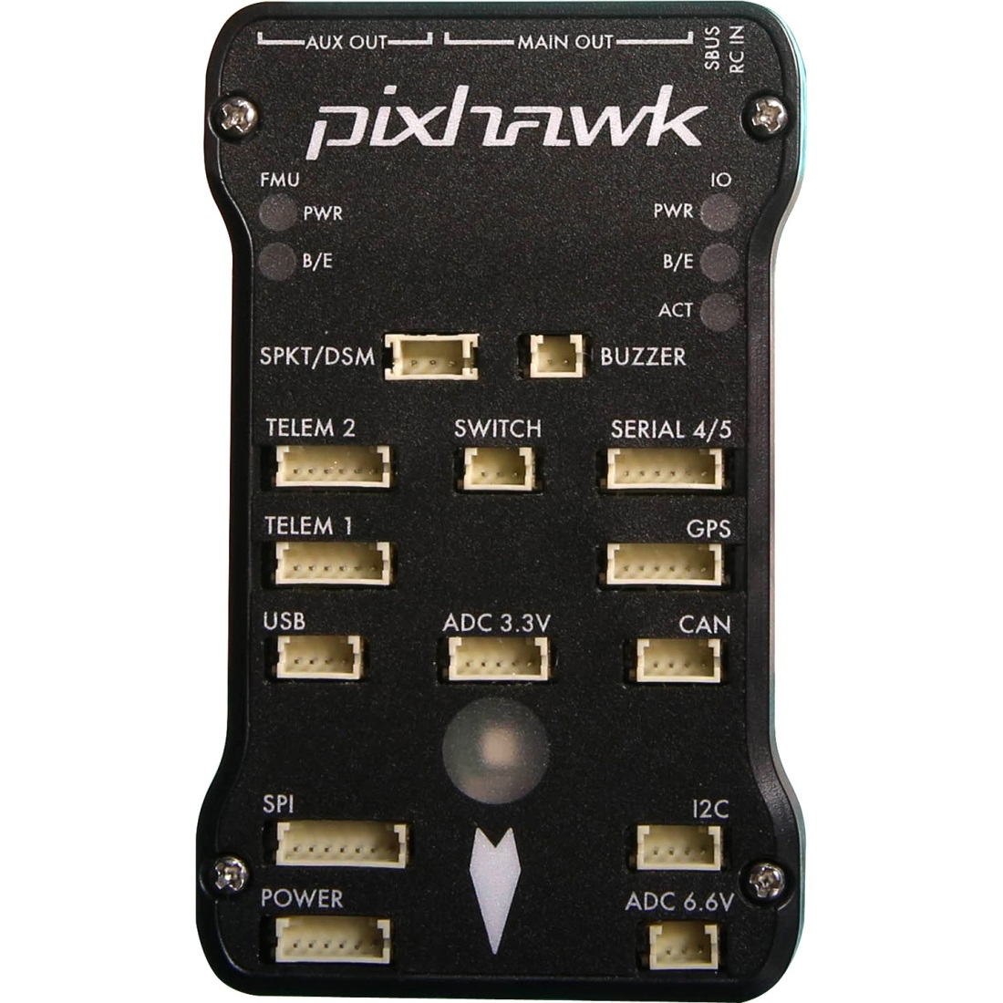
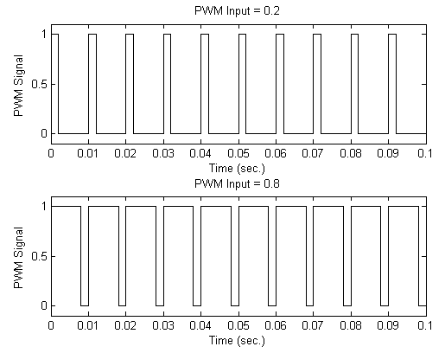
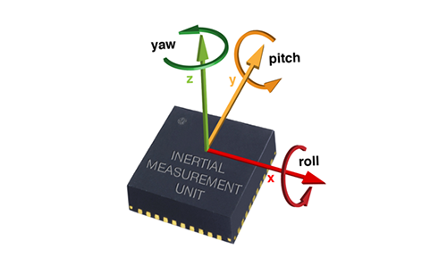
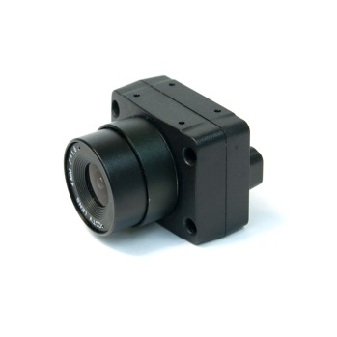
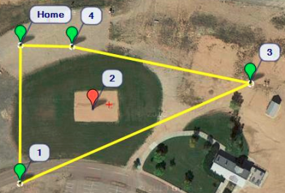
Pixhawk: A Flight Computer
Input:
Sensor Data + Reference
Output:
Commands to motors for:
GPS
IMU
Camera
Reference
https://pixhawk.org/modules/pixhawk

Slide 26
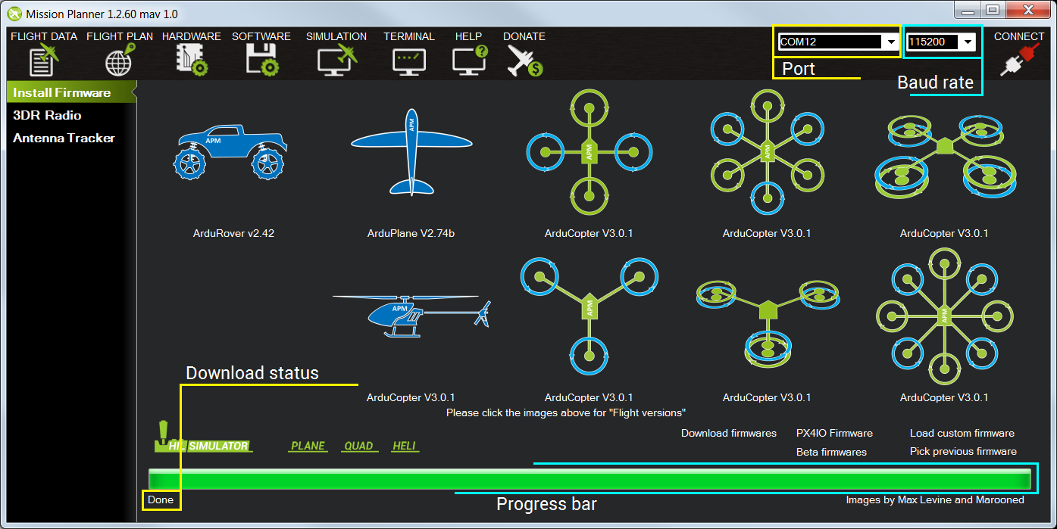
Ground Station Software
Robot Selection and Sensor calibration
http://ardupilot.org/copter/docs/common-choosing-a-ground-station.html

Slide 27
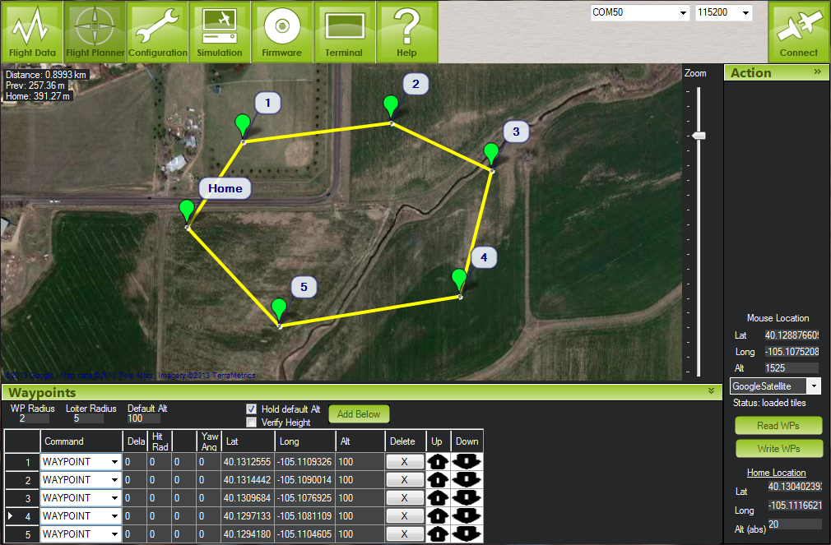
Ground Station Software
GUI to select Waypoints for flight (outdoor, via GPS)

Slide 28
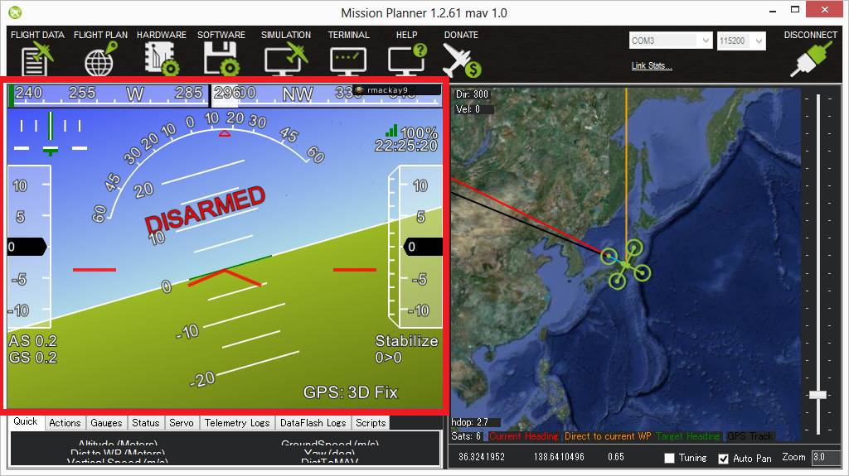
Ground Station Software – Mission Planner
Fly (click on picture below for video link)
2013 - https://www.youtube.com/watch?v=XkG9ERd_UDk&feature=youtu.be&t=59
2014 - https://www.youtube.com/watch?v=Sd_AT6qtDlw

